Slide 1
INVEST IN ITALY
Investment opportunities in Italy
Logistics

Slide 2


INFRASTRUCTURE
OPPORTUNITIES
1
PORTS
Trieste Pier VIII – Logistics Platform
Taranto Logistics Platform
OUR OFFER
2
Taranto Distripark
Porto Nogaro Logistics Parl
RETRO PORT AREAS
3
Lamezia Terme Intermodal Platform
New Bergamo Cargo Terminal
AIRPORTS
4
FREIGHT VILLAGES
Nola Freight Village’s Development

Slide 3


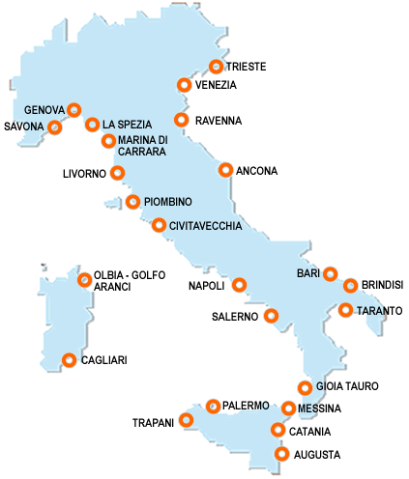
ITALIAN PORT SYSTEM AT A GLANCE
ITALIAN PORTS – CONTAINER THROUGHPT - TEUs* 2017
10 mln
TEUs*
1,5 mln
15%
50%
5 mln
50%
1 mln
10%
25%
15%
(HUB)
2,5 mln
25%
10%
(HUB)
(HUB)
* TEU =Twenty-foot Equivalent Unit
Source: Assoporti 2018

Slide 4
ITALIAN PORT SYSTEM
CONTAINER THROUGHPUT
HOW TO INVEST IN ITALIAN PORTS?
Seaports are defined by the Italian law as public domain, which is State owned and inalienable. The State manages the major ports through the Authority Port System, Public bodies working under the control of the Ministry of Infrastructure.
The Authorities do not perform any direct activity but they have the power to give in “concession portions of port territory, equipped or not, to private actors against payment of a fee”.
Concessions take the form of BOT, the type of PF more frequently used by foreign investors in Italian ports.

Slide 5
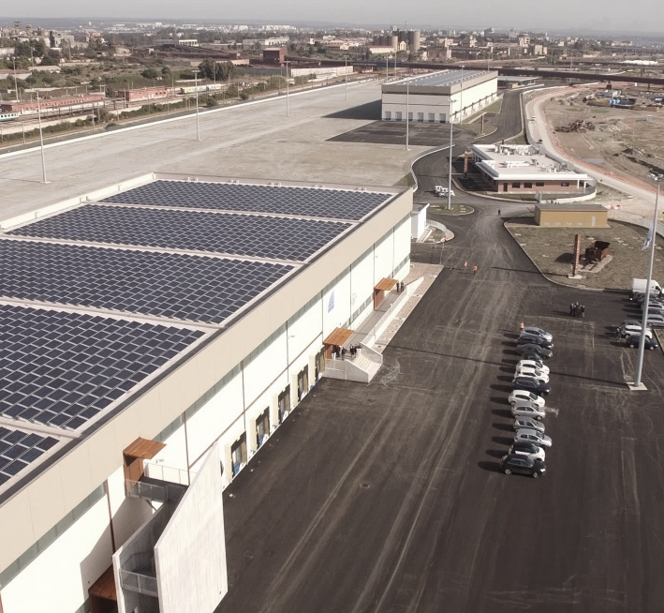




TARANTO LOGISTICS PLATFORM
200.000 sq.m.
POTENTIAL TARGET: FOOD PROCESSING GROUPS
Room temperature warehouse
The warehouse has an area of 4.836 sqm.
Rail link
The Logistic Park Railway tracks will be linked to the Taranto railway station and the national railway network
Container storage yard
The yard extends over an area of 25.700 sqm where up to 480 containers can be stacked..
Refrigerated warehouse
The warehouse has an area of about 5.376 sqm and a capacity of 48.000 cm. It is dedicated to the storage of perishable goods. There are four refrigerated cells where temperature can vary from -25 ° C a + 5 ° C.

Slide 6
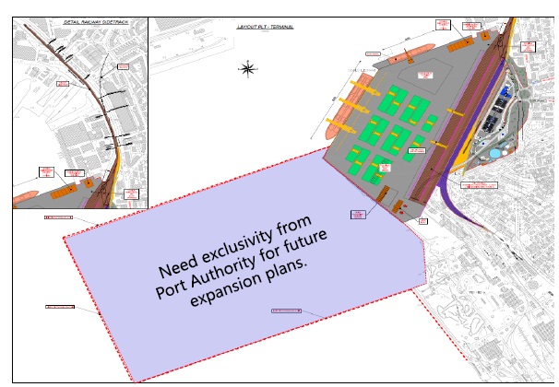
TRIESTE LOGISTICS PLATFORM
PHARMACEUTICAL SECTOR
POTENTIAL TARGET: MARITIME TERMINAL COMPANIES AND SHIPPING COMPANIES
Berth size and depth:
Container= 420m (-14m)
Ro-Ro/bulk= 400m (-10.5m)
Total area: 27hectares
Design throughput
Container= 450,000 TEUs/year
Ro-RO/bulk= pending
Investment
422 M/€ in 4 phases
Concession
up to 60 years (from start of operation)

Slide 7
INFRASTRUCTURE
OPPORTUNITIES
1
PORTS
Trieste Pier VIII – Logistics Platform
Taranto Logistics Platform
OUR OFFER
2
Taranto Distripark
Porto Nogaro Logistics Park
RETRO PORT AREAS
3
Lamezia Terme Intermodal Platform
New Bergamo Cargo Terminal
AIRPORTS
4
FREIGHT VILLAGES
Nola Freight Village’s Development

Slide 8
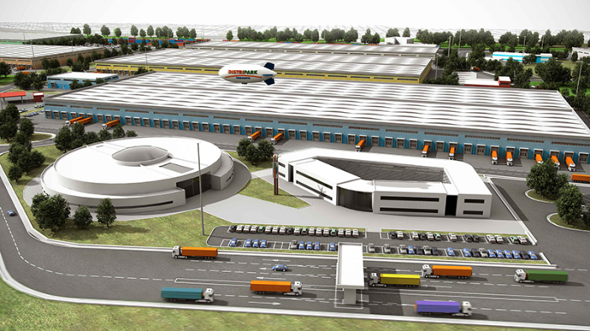
DISTRIPARK TARANTO
DISTRIPARK – Taranto (Apulia)
POTENTIAL TARGET:
REAL ESTATE DEVELOPERS AND LOGISTICS COMPANIES
The area for construction is located near the Port of Taranto where an intermodal transport infrastructure of national importance will be built. The development venture, due to its proximity to the port, the Container Terminal and the new Logistics Platform, represents an excellent opportunity for all companies interested in Southern Europe and the Mediterranean, with significant advantages also linked to its inclusion in the Special Economic Zone for the Port of Taranto.

Slide 9
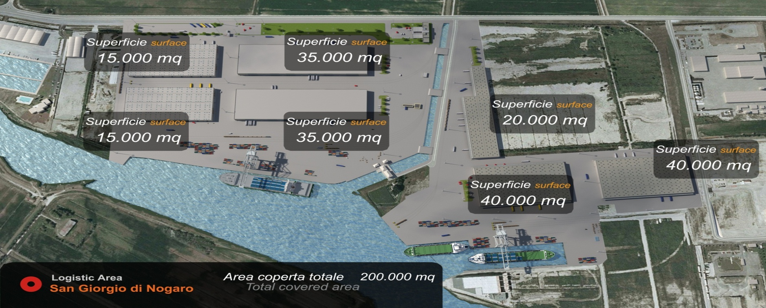
PORTO NOGARO LOGISTICS PARK
HUMAN TECNOPOLE
LOCATION: Friuli Venezia Giulia, 65 Km North Trieste
TYPE OF BUSINESS: Real Estate
TOTAL AREA: 520.000 sqm.
AREA TO BE COVERED: 200.000 sqm.
ACQUISITION COSTS: 39 M/€ (520.000 sqm. X 75€/sqm)
POTENTIAL TARGET:
INVESTMENT FUNDS AND REAL ESTATE DEVELOPER

Slide 10
INFRASTRUCTURE
OPPORTUNITIES
1
PORTS
Trieste Pier VIII – Logistics Platform
Taranto Logistics Platform
OUR OFFER
2
Taranto Distripark
Porto Nogaro Logistics Park
RETRO PORT AREAS
3
Lamezia Terme Intermodal Platform
New Bergamo Cargo Terminal
AIRPORTS
4
FREIGHT VILLAGES
Nola Freight Village’s Development

Slide 11
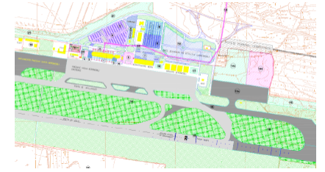
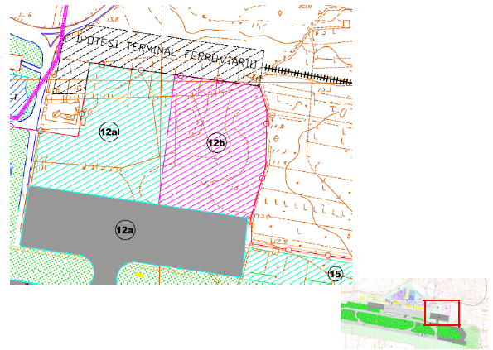
LAMEZIA TERME AIRPORT
INTERMODAL PLATFORM
Cargo Development in collaboration with Gioia Tauro port
New warehouse and parking to be developed in a separated expansion area
Full integration with the Special Economic Zone
First Phase:
total area 180.000 sqm.
investment € 30/M
Second phase:
67.000 sqm.
Investment: €10/M
POTENTIAL TARGET:
AIRPORT MANAGING COMPANIES AND CONNECTED LOGISTICS PARTNERS

Slide 12
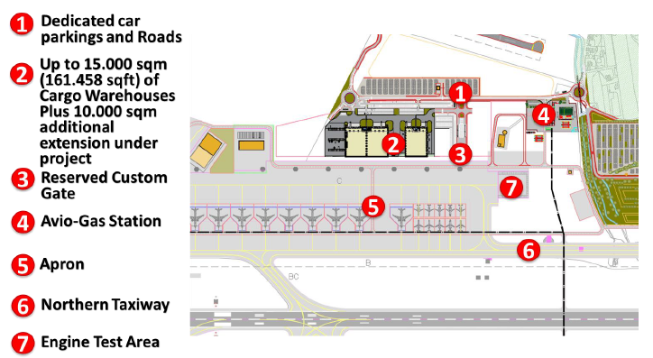
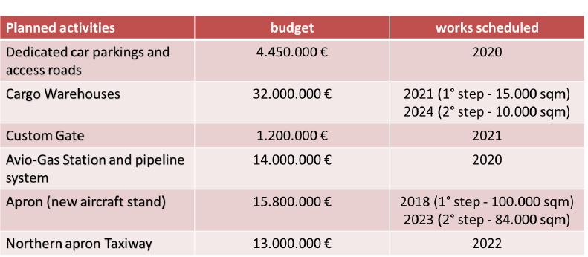
NEW BERGAMO AIRPORT CARGO TERMINAL
POTENTIAL TARGET:
REAL ESTATE DEVELOPERS, COURIERS, AIR FREIGHT FORWARDING AND LOGISTICS COMPANIES
Warehouse details
1 Building of 10.000 sqm. and 22,5 m. high
1 Building of 5.000 sqm. and 22.5 m. high
Further 10.000 sqm. of building surface for warehouse and offices extension

Slide 13
INFRASTRUCTURE
OPPORTUNITIES
1
PORTS
Trieste Pier VIII – Logistics Platform
Taranto Logistics Platform
OUR OFFER
2
Taranto Distripark
Porto Nogaro Logistics Park
RETRO PORT AREAS
3
Lamezia Terme Intermodal Platform
New Bergamo Cargo Terminal
AIRPORTS
4
FREIGHT VILLAGES
Nola Freight Village’s Development

Slide 14

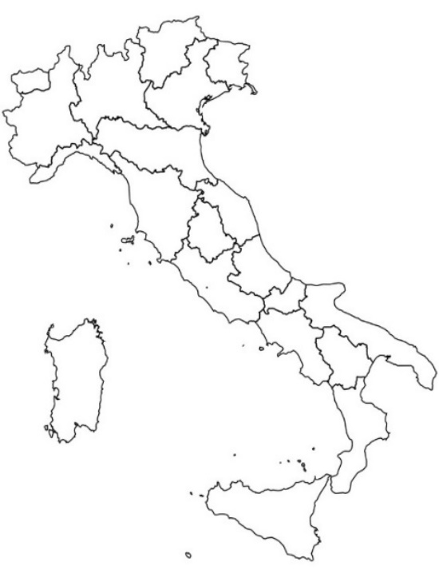
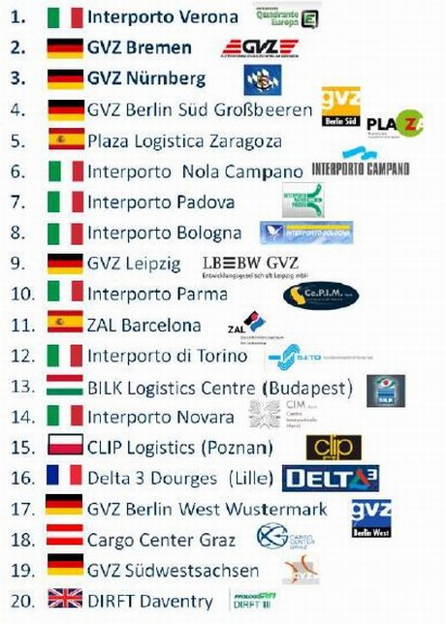
INFRASTRUCTURE
GENERAL ENVIRONMENT – Focus
FREIGHT VILLAGES
Italy holds 7 among the 15 best European
Verona ranking first
14th
7th
1st
Integrated systems of logistics infrastructures for rail, road and intermodal freight transport
Real estate opportunities localized in the most industrialized areas of Italy
Natural location for logistics and manufacturing companies looking for high quality solutions in order to set up a distribution centre for the European Market
12th
8th
10th
6th
Source: Independent study provided by a German consultant - 2015

Slide 15
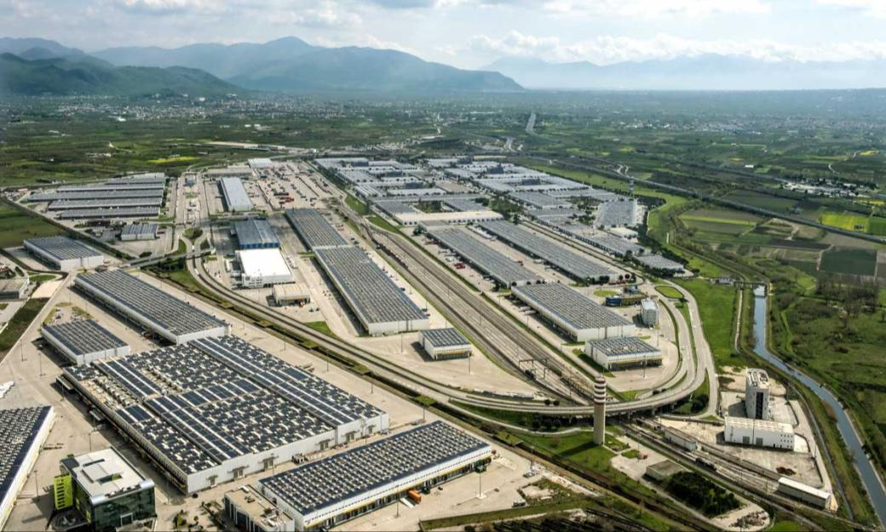
NOLA FREIGHT VILLAGE AT A GLANCE

Slide 16
NOLA FREIGHT VILLAGE: POTENTIAL
TARGETS
GLOBAL
JV/Partnership to develop the logistics business and the whole Business Park
Target Investors
Financial investors (i.e. private equity firms or investment funds)
International players specialized in Logistics Real Estate (i.e. developers, international logistics companies)
International players specialized in freight village activities (i.e. intermodal operator, rail traction companies)
JV/Partnership to develop new business within the Business Park
Rail transport business
Real Estate Logistics Development
SPECIFIC
Acquisition portfolio/subportfolio warehouses (for direct use and/or investment and/or business development)
Collateral business (energy)
Operating Platforms in Business Park/CIS (servi ce/logistics/industry 4.0/Light Industrial)

