Slide 1



THE POWERPOINT PRESENTATION
ITALY
THE IDEAL HUB FOR IT INVESTMENTS
July, 2020

Slide 2

CONTENTS
Market outlook
Talent pool
Innovation ecosystem
Government commitment
Incentives and fiscal benefits
FDI case studies
2

Slide 3
IT IN ITALY: KEY FACTS
4th digital market in Europe with over € 70 bln turnover
The most growing segment is IT software and devices (+5,8%)
Rapid and relevant growth for software applications in Cloud computing (+21,5%), IoT (+18,3%), and Cybersecurity (+13%)
Extraordinary talent pool for software development
Creative, skilled, loyal HR, devoted to entrepreneurship: about 5K IT innovative startups
Over 45 K graduates and more than 250 K students in ICT-related disciplines
3rd in the EU for no. of employees in IT and TLC
Cutting edge R&D in computer science
1st in the world for publications per researcher
Vibrant innovation ecosystem with 16 tech universities, 8 competence centers, and multiple science parks, incubators, accelerators, and more
Wide range of ad hoc incentives and fiscal benefits – from large scale investments to startups, from R&D to Industry 4.0
Home to about 900 foreign IT and TLC companies
And remarkable recent track record, including Microsoft, IBM, NTT Data, Cisco, Huawei, and many others
3

Slide 4



Market outlook

Slide 5


DIGITAL MARKET
A prominent Digital Market
2018-2020E Italian Digital Market (value in € mln and % variations)
70.473
71.932
69.736
4th European digital market
Market value exceeding € 70 bln in 2019
+2,1% market growth in 2019
Noteworthy is the +5,8% ICT software and devices sub-sector growth
2020 scenario reflects the negative impact of the global economic crisis caused by COVID-19
Source: Il Digitale in Italia 2020. Mercati, Dinamiche, Policy, Confindustria Digitale, Anitec-Assinform / NetConsulting cube, June 2020.
5
Notes:
Il mercato digitale italiano nel 2019 ha proseguito il trend positivo degli scorsi anni segnando un incremento del 2,1% e un valore di circa 72 miliardi di euro. Il principale fattore alla base della crescita è il percorso di digitalizzazione intrapreso dalle aziende in tutti i settori, che si riflette nell’andamento positivo dei Servizi ICT (+5,8%), trainati dalla crescente penetrazione del Cloud quale elemento chiave del processo di modernizzazione di sistemi e applicazioni e dell’IoT, oltre che in generale dai progetti di System Integration.
Le previsioni per il 2020, a inizio anno ancora positive e volte a confermare la crescita del 2019, sono state inevitabilmente influenzate negativamente dalla crisi economica innescata dalla pandemia Covid-19 sia a livello mondiale sia, in misura anche più grave, sull’Italia, considerato che il nostro Paese è stato fra quelli più colpiti.
Il mercato digitale per il prossimo anno è previsto in calo del 3,1%, in misura inferiore rispetto al PIL e con andamenti differenziati tra i diversi segmenti. Le previsioni sono elaborate sulla base di uno scenario prudenziale basato sull’ipotesi che si verifichino le seguenti condizioni: una lenta ripartenza dell’economia nei mesi di maggio e giugno, per effetto della ripresa di molte delle principali attività produttive, e una riduzione dei numeri di contagio nei mesi a seguire, che dovrebbe consentire un recupero nel secondo semestre.

Slide 6


DIGITAL ENABLERS
Cloud: key for digital transformation
Cloud Computing in Italy (value in € mln and % variations)
3.282,4
+ 21,5% market growth rate in 2019
+ 29% for Public Cloud
+ 23,7% for Hybrid Cloud
Cloud is also used significantly to support the launch of new product lines or business units and the adoption of specific vertical applications
2.701,5
2.214,3
Source: Il Digitale in Italia 2020. Mercati, Dinamiche, Policy, Confindustria Digitale, Anitec-Assinform / NetConsulting cube, June 2020.
6
Notes:
Nel 2019, il mercato del Cloud Computing ha continuato a crescere registrando un incremento del 21,5%, solo di poco inferiore a quanto rilevato l’anno precedente. Gli investimenti degli utenti italiani sono risultati sempre polarizzati, per valori e crescita, sui servizi di Public e Hybrid Cloud che detengono assieme oltre il 67% del mercato complessivo con tassi di incremento rispettivamente del 29% e del 23,7%. Se si considera la spesa sostenuta per la realizzazione di architetture di Public, Hybrid e Virtual Private Cloud, la maggioranza degli investimenti è riconducibile a servizi IaaS (53,1%), SaaS (41,5%) e PaaS (5,5%). I major spender del mercato Cloud sono i comparti industriali, le banche, i player della distribuzione e i service provider con un peso particolarmente rilevante delle utility. In linea con la loro maggiore capacità di spesa, la maggioranza del mercato per dimensioni aziendali (68% circa) è riconducibile al segmento delle aziende Top.

Slide 7
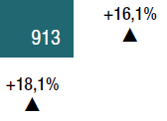
DIGITAL ENABLERS
IoT: fulcrum of the digital evolution
Internet of Things in Italy (value in € mln and % variations)
Over € 3.500 mln of turnover in 2019 with a +18,3% growth rate vs 2018
Sensors and software platforms for IoT are at the heart of the concept of intelligent & super-connected industry → Connected Enterprise
Source: Il Digitale in Italia 2020. Mercati, Dinamiche, Policy, Confindustria Digitale, Anitec-Assinform / NetConsulting cube, June 2020.
7
Notes:
Il mercato italiano dell’Internet of Things nel 2019 ha superato il valore di 3.500 milioni di euro, con un incremento del 18,3% rispetto al 2018. Gli investimenti in quest’ambito hanno definito una delle aree di maggiore interesse per le principali aziende italiane, insieme agli investimenti in Cloud, Analytics e Cybersecurity. I sensori e le piattaforme software per l’IoT sono alla base del concetto di industria intelligente e super connessa (Connected Enterprise).

Slide 8


DIGITAL ENABLERS
Cybersecurity: ever-connected systems
Cyber Security in Italy (value in € mln and % variations)
1.136,5
1.005,8
3.282,4
Over € 1 bln of turnover in 2019 with a +13% growth rate
The most impacting sub-sector is the Managed Security Services (MSS) and Cloud Security with a 14,7% growth rate and about € 450 mln of turnover
896,5
2.701,5
2.214,3
Source: Il Digitale in Italia 2020. Mercati, Dinamiche, Policy, Confindustria Digitale, Anitec-Assinform / NetConsulting cube, June 2020.
8
Notes:
Il mercato della Cybersecurity è cresciuto anche nel 2019, a un tasso (+13%) superiore alla media del mercato digitale italiano e raggiungendo 1.136,5 milioni di euro.
La componente di Security Managed Services e Cloud Security, con una crescita del 14,7% e un valore di 444,4 milioni di euro, è l’ambito che incide di più sugli investimenti in Cybersecurity.
Gli altri servizi di sicurezza, che comprendono la System Integration e la formazione specifica, hanno raggiunto quota 423 milioni di euro, rappresentando la seconda componente più rappresentativa del comparto, con una crescita del 10,5%. Rientrano in questa categoria attività periodiche come l’assessment e l’audit per la rilevazione delle vulnerabilità e la relativa mitigazione.
A presentare il più alto tasso di crescita sono i comparti Consulenza (+15,4%) e Security Hardware (+15,6%). I servizi di consulenza, in particolare, hanno raggiunto 62,6 milioni di euro nel 2019, grazie alle attività di revisione interna dei processi in ottica security by-design, di supporto alle attività di compliance e risk mananagment e di rafforzamento di policy e procedure.
MSS: Managed Security Services
Other Services: System integration, Formazione

Slide 9
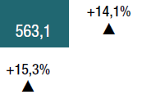
DIGITAL ENABLERS
Cutting edge Wearable Technologies
Wearable Technologies (value in € mln and % variations)
Over € 640 mln of turnover in 2019 with a +14,1% growth rate vs 2018
Smartwatch and Ear-worn devices are the most relevant sub-sectors
Source: Il Digitale in Italia 2020. Mercati, Dinamiche, Policy, Confindustria Digitale, Anitec-Assinform / NetConsulting cube, June 2020.
9
Notes:
Il mercato delle Tecnologie Wearable – smart device, dispositivi/sensori indossabili, che permettono la raccolta dati in tempo reale e il dialogo rete-dispositivo senza l’intervento umano – nel 2019 ha superato 640 milioni di euro con un incremento del 14,1% rispetto al 2018. Secondo le previsioni, la crescita continuerà nel 2020, pur con il rallentamento dovuto all’emergenza pandemica.
In termini di valore di mercato, gli smartwatch si confermano il segmento più importante insieme ai dispositivi ear-worn. Secondo uno studio condotto da ABI Research, entro il 2021 saranno consegnati in tutto il mondo 154 milioni di dispositivi wearable, di cui 52 milioni destinati al mondo della logistica e dell’industria.

Slide 10
Talent Pool

Slide 11
R&D PRODUCTIVITY
Employment in the ICT sector in the EU
2017 Top EU countries for no. of ICT employees (NACE Codes J 61, 62, 63)
61 – Telecommunications
Italy ranks 3rd in the EU for no. of employees in the ICT sector
62 – Computer programming, consultancy and related activities
63 – Information service activities
Source: Eurostat
11
Notes:
Annual enterprise statistics for special aggregates of activities (NACE Rev. 2) - Eurostat
NACE Rev.2: J-61, J-62, J-63
Indicator: number of employees
Time: 2017
United Kingdom: 222.048 (61), 702.365 (62), 76.089 (63) = 1.000.502
France: 160.376 (61), 419.325 (62), 35.300 (63) = 615.001
Germany: 101.020 (61), 674.877 (62), 98.161 (63) = 874.058
Italy: 90.195 (61), 239.351 (62), 89.448 (63) = 418.994
Spain: 62,339 (61), 248.455 (62), 22.352 (63) = 333.146
Netherlands: 31.499 (61), 168.161 (62), 15.032 (63) = 214.692
Sweden: 26.013 (61), 125.457 (62), 10.195 (63) = 161.665
Belgium: 22.394 (61), 54.721 (62), 4.640 (63) = 81.755
Austria: 14.285 (61), 43.926 (62), 17.776 (63) = 75.987
Denmark: 14.263 (61), 51.064 (62), 7.779 (63) = 73.106
Ireland: 12.276 (61), 55.100 (62), 6.126 (63 in 2014) = 73.502
Finland: 11.685 (61), 55.760 (62), 6.044 (63) = 73.489

Slide 12
HUMAN CAPITAL
Academic human capital
Students and graduates in ICT-related disciplines
University courses | Graduates | Students
Computer science | 3.933 | 33.007
Engineering and engineering trades | 37.425 | 201.887
Mathematics and Statistics | 3.744 | 15.767
TOTAL | 45.102 | 250.661
Italian universities generates a large number of students and graduates in Computer science, Engineering, Statistics, and Mathematics.
Source: MIUR (Ministry of Education University and Research)
12
Notes:
Computer science - Informatica e tecnologie ICT (classe nome):
Informatica
Scienze e tecnologie informatiche
Sicurezza informatica
Tecniche e metodi per la società dell’informazione
Engineering and engineering trades - Ingegneria industriale e dell’informazione (classe nome):
Ingegneria aerospaziale e astronautica
Ingegneria biomedical
Ingegneria chimica
Ingegneria della sicurezza
Ingegneria dell’automazione
Ingegneria delle telecomunicazioni
Ingegneria dell’informazione
Ingegneria elettrica
Ingegneria elettornica
Ingegneria energetica e nucleare
Ingegneria gestionale
Ingegneria industriale
Ingegneria informatica
Ingegneria meccanica
Ingegneria navale
Modellistica matematico-fisica per l’ingegneria
Scienza e ingegneria dei materiali
Mathematics and statistics (classe nome):
Matematica
Scienze matematiche
Scienze statistiche
Statistica
Scienze statistiche attuariali e finanziarie
Statistica economica, finanziaria e attuariale
Statistica per la ricerca sperimentale

Slide 13
R&D PRODUCTIVITY
Researchers’ publications
Top 10 Countries for no. of publications per researcher in 1996-2017 (absolute value)
Italy ranks 1st in the world for publications per researcher
Source: Elaboration of The European House – Ambrosetti on SCImago and OECD databases, 2019.
13
Notes:
Numero di pubblicazioni per ricercatore: primi 10 Paesi al mondo per pubblicazioni negli ultimi 21 anni, valore assoluto, 1996-2017. Fonte: elaborazione The European House – Ambrosetti su dati Scimago e OECD, 2019.

Slide 14
R&D PRODUCTIVITY
Increasing quality of research
2018 Patent productivity in top 5 European Countries (% value)
Italy is a top player for the very high quality of its research and innovations
Source: Elaboration of The European House – Ambrosetti on European Patent Office database, 2019.
14
Notes:
Patent productivity, understood as the ratio of patent applications filed and approved, has increased in recent years in Europe from 42,8% in 2015 to 73,2% in 2018. This index represents the quality of the research and innovations that are proposed and its considerable increase in recent years is a sign of the increasing quality of research, which implies more business opportunities related to patents coming onto the market.
Italy ranks:
10th in the world for total patent applications (direct and PCT national phase entries) in 2018: 32.286 [Total count by applicant’s origin].
11th in the world for total patent grants (direct and PCT national phase entries) in 2018: 22.224 [Total count by application’s origin]
In the top 20 worldwide for patent publications and grants in telecommunications, computer technology, IT methods for management, and audio-visual technology:
Telecommunications
14th in the world for patent publications in 2018: 203 [Total count by applicant’s origin]
16th in the world for patent grants in 2018: 101
Computer technology
19th in the world for patent publications in 2018: 482
18th in the world for patent grants in 2018: 219
IT methods for management
14th in the world for patent publications in 2018: 192
19th in the world for patent grants in 2018: 23
Audio-visual technology
17th in the world for patent publications in 2018: 212
18th in the world for patent grants in 2018: 125

Slide 15
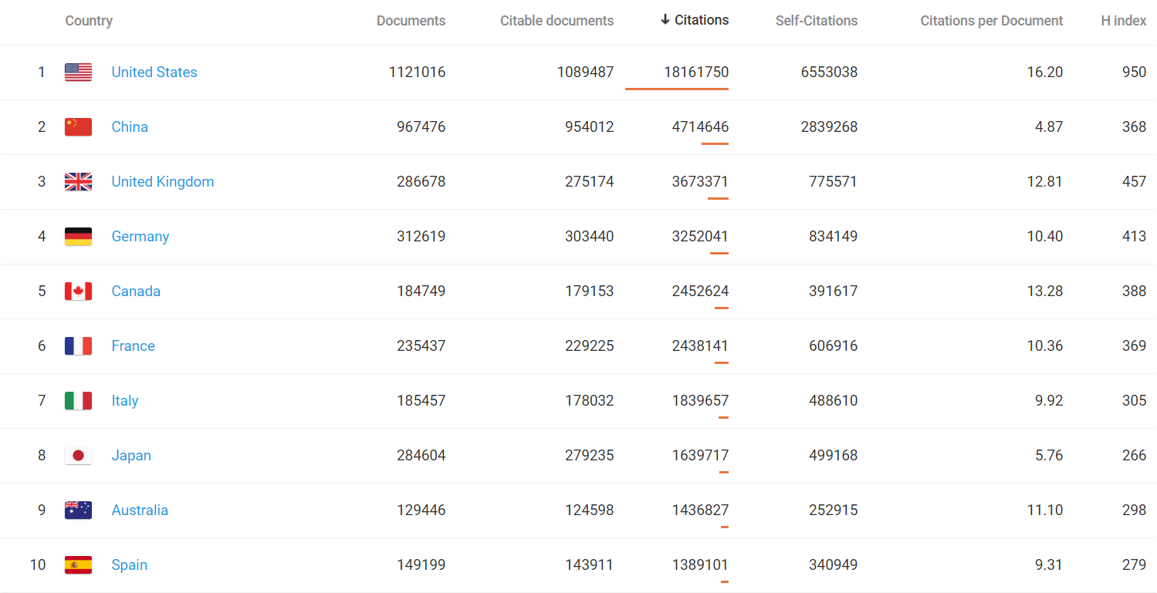
R&D PRODUCTIVITY
Citations in computer sciences
Italy ranks 7th in the world for citations in Computer sciences in 1996-2018
Source: SCImago, (n.d.). SJR — SCImago Journal & Country Rank [Portal]. Retrieved Date you Retrieve, from http://www.scimagojr.com
15
Notes:
Italy ranks 7° for citations and 8° for publications in the world in Computer sciences in 1996-2018.
Sub-sectors of Computer sciences
5° in the world for no. of citations in computer networks and communications in 2018
5° in the world for no. of citations in computer science applications in 2018
7° in the world for no. of citations in software in 1996-2018 and in 2018
8° in the world for publications in artificial intelligence in 2018

Slide 16
WORKING COMMITMENT
Hard working attitude
2018 Average annual hours actually worked (hours per worker)
Italy ensures a high level of commitment in terms of hours worked and energy from its workers
Source: OECD database.
16
Notes:
The concept used is the total number of hours worked over the year divided by the average number of people in employment. Part-time workers are covered as well as full-time workers.

Slide 17
WORKING COMMITMENT
Labour cost competitiveness
2019 Labour cost of employees in the information and communication sector (thousand value)
Italy is extremely competitive in terms of labour cost
Source: Eurostat.
17
Notes:
Labour cost levels by NACE Rev. 2 activity
NACE Rev. 2: Information and communication
Labour cost structure: Labour cost for LCI (compensation of employees plus taxes minus subsidies)
Unit of measure: Euro

Slide 18






ITALIAN ENTREPRENEURSHIP
A Country of Entrepreneurs
1st in Europe for no. of enterprises (over 3,7 mln)
Followed by FR (2,8 mln), ES (2,6 mln), DE (2,5 mln), GB (2,1 mln),
NL (1,2 mln)
1st in Europe for no. of Manufacturing companies
3rd in Europe for no. of ICT companies
Vibrant system where to startup (over 11K innovative startups)
Source: Eurostat
18
Notes:
Annual enterprise statistics for special aggregates of activities (NACE Rev. 2)
https://appsso.eurostat.ec.europa.eu/nui/submitViewTableAction.do
Indicator: number of enterprises
Italy
2008: 3.948.726
2009: 3.889.543
2010: 3.867.813
2011: 3.843.454
2012: 3.825.458
2013: 3.770.844
2014: 3.715.164
2015: 3.683.127
2016: 3.719.596
2017: 3.712.043
Ranking with other countries:
FR: 2.783.993
ES: 2.661.427
DE: 2.504.371
GB: 2.144.122
NL: 1.160.015

Slide 19
ITALIAN ENTREPRENEURSHIP
IT Business demography in the EU
2020 Top EU countries for no. of ICT companies (NACE Codes J 61, 62, 63)
61 – TLC
Italy ranks 3rd in the EU for no. of companies in the ICT sector
62 – Computer programming, consultancy and related activities
63 – Information service activities
Source: Eurostat
19
Notes:
Annual enterprise statistics for special aggregates of activities (NACE Rev. 2) - Eurostat
NACE Rev.2: Total business economy; repair of computers, personal and household goods; except financial and insurance activities
Indicator: number of enterprises
Germany: 94.674 (62), 13.305 (63), 3.111 (61) = 111.090
France: 74.363 (62), 10.104 (63), 3.165 (61) = 87.632
Italy: 49.036 (62), 34.469 (63), 4.626 (61) = 88.131
Netherlands: 63.063 (62), 8.838 (63), 1.300 (61) = 73.201
Spain: 37.778 (62), 13.305 (63), 3.111 (61) = 50.959
United Kingdom: 161.662 (62), 8.091 (63), 8.460 (61): 178.213

Slide 20
ITALIAN ENTREPRENEURSHIP
IT Startups – 2Q 2020
Innovative startups in IT-related fields
IT Sub-Sector | No. of innovative startups 2Q 2020 | % of the innovative startups / tot no. of startups in Italy
(J 62) Software production, IT consulting and related activities | 4.093 | 35,60
(J 63) Information service activities and other IT services | 1.032 | 8,98
TOTAL | 5.125 | 44,58
Over 40% of Italian innovative startups (equal to 11.496) are involved in the IT sector
Source: «Report con dati strutturali Startup innovative. 2°trimestre 2020», Unioncamere, MiSE, InfoCamere, Luglio 2020.
20
Notes:
Al termine del 2° trimestre 2020, il numero di startup innovative iscritte alla sezione speciale del Registro delle Imprese ai sensi del decreto legge 179/2012 è pari a 11.496, in aumento di 290 unità (+2,6%) rispetto al trimestre precedente.
Per quanto riguarda la distribuzione per settori di attività, il 73,3% delle startup innovative fornisce servizi alle imprese (in particolare, prevalgono le seguenti specializzazioni: produzione di software e consulenza informatica, 35,6%; attività di R&S, 13,8%; attività dei servizi d’informazione, 9,0%), il 17,9% opera nel manifatturiero (su tutti: fabbricazione di macchinari, 3,2%; fabbricazione di computer e prodotti elettronici e ottici, 2,8%;), mentre il 3,3% opera nel commercio.

Slide 21
LOYALTY
Employees’ loyalty to companies
2018 Employment by job tenure intervals at European level (average tenure in years)
Italy ranks 1st in the world for loyalty of employees towards their main employer
Source: Elaboration on OECD database.
21
Notes:
Job tenure is measured by the length of time workers have been in their current or main job or with their current employer and are expressed in numbers of years. They can be converted in months by multiplying by a factor of 12 (months).

Slide 22

Innovation Ecosystem

Slide 23

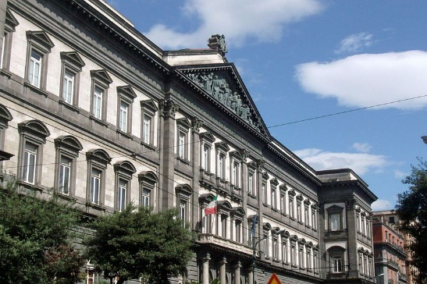
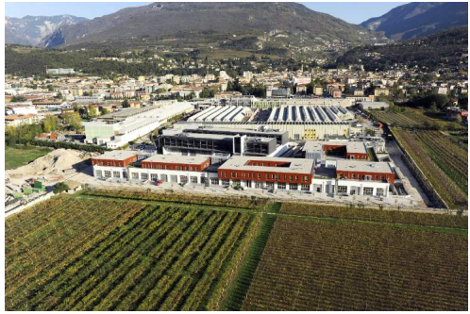
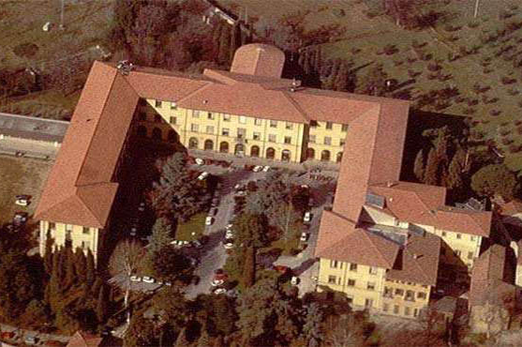
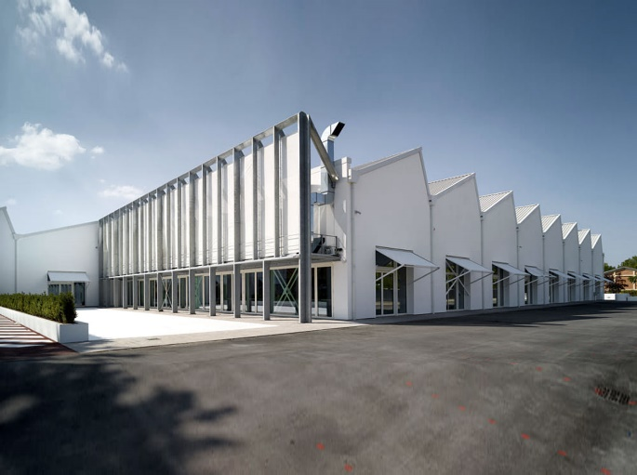
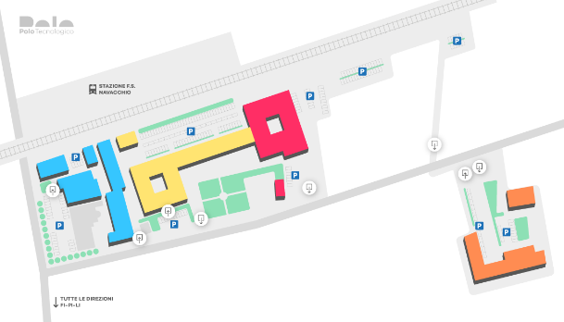
INNOVATION ECOSYSTEM
Key players
RESEARCH & DEVELOPMENT INSTITUTES
UNIVERSITY ECOSYSTEM
16 science and tech universities
10 CNR Centers
5 tech centers of excellence
INDUSTRY 4.0 COMPETENCE CENTERS
SCIENCE PARKS & INCUBATORS AND ACCELERATORS
8 competence centers
8 science parks
138 incubators and accelerators
23

Slide 24







UNIVERSITY NETWORK
Science and
Tech Universities
University of Trento
Politecnico, Milan
Politecnico, Turin
University of Trieste
University of Padova
University of Bologna
University of Genova
In general, Italian universities improve their positions in the World University Ranking: 4 more than last year!
University of Ancona
Scuola Superiore Sant’Anna, Pisa
University of L’Aquila
University La Sapienza, Rome
Politecnico, Bari
University of Cagliari
University Federico II, Naples
University of Calabria, Cosenza
..and many more
University of Catania
Source: QS World University Rankings by Subject 2020
24

Slide 25
R&D INSTITUTES AND CENTERS
R&D Centers
of excellence
STIIMA
(Manufacturing 4.0)
Milan
Cefriel
Milan
Bruno Kessler Foundation
Trento
IMATI
(Applied Mathematics and IT)
Pavia
IEIIT
(Information & Telcom)
Turin
The National Research Council (CNR) is the largest public research institution in Italy, the only one under the Research Ministry performing multidisciplinary activities, through several institutes.
E.g. The Italian Institute of Technology accounts for over 13,000 publications, over 200 European projects, over 40 ERC projects, over 900 active patent applications, 22 established startups. Also, it accounts for 11 IIT research centers in Italy and 2 outstations located abroad (MIT and Harvard in the US).
Italy is also characterized by several other IT centers of excellence, some of which are indicated in the map.
Istituto Superiore M. Boella
Turin
Italian Institute of Technology
Genoa
IIT
(Informatics & Telematics)
Pisa
ISTI
(Information science & tech)
Pisa
IAC
(Computing application)
Rome
IASI
(Informatics)
Rome
IREA
(Environmental electromagnetism)
Naples
ICAR
(Computing and Networks)
Cosenza
CRS4
Cagliari
IMM
(Microelectronics)
Catania
Source: CNR website
25
Notes:
Centri CNR
IMM, Catania: Istituto per la microelettronica e microsistemi
IAC, Roma: Istituto per le Applicazioni del Calcolo
IASI, Roma: Istituto di Analisi dei Sistemi e Informatica
ICAR, Rende (Cosenza): Istituto di Calcolo e Reti ad Alte Prestazioni
IEIIT, Torino: Istituto di Elettronica e di Ingegneria dell’Informazione e delle Telecomunicazioni
IIT, Pisa: Istituto di Informatica e Telematica
IMATI, Pavia: Istituto di Matematica Applicata e Tecnologie Informatiche
IREA, Napoli: Istituto per il Rilevamento Elettromagnetico dell’Ambiente
ISTI, Pisa: Istituto di Scienza e Tecnologie dell’Informazione
STIIMA (Ex ITIA), Milano: Istituto di Sistemi e Tecnologie Industriali Intelligenti per il Manifatturiero Avanzato
Altri centri di eccellenza
Cefriel, Milano: Consorzio per la Formazione e la Ricerca in Ingegneria Elettronica
FBK, Trento: Fondazione Bruno Kessler con 4 Centri di Ricerca →
1. Centro per le Tecnologie dell’Informazione e della Comunicazione (ICT)
2. Centro Materiali e Microsistemi (CMM)
3. Centro di Ricerca e Sperimentazione della telecomunicazione per le comunità in rete (CREATE-NET)
4. Centro Europeo per gli Studi Teorici in Fisica Nucleare e Settori Collegati (ECT)
ISMB, Torino: Istituto Superiore Mario Boella
IIT, Genova: Istituto Italiano di Tecnologia
CRS4, Cagliari: Centro di Ricerca, Sviluppo e Studi Superiori in Sardegna

Slide 26
SCIENCE PARKS and
INCUBATORS AND ACCELERATORS
Innovation
Hubs
Kilometro Rosso,
Bergamo
Noi Tech Park,
Bolzano
ComoNExT,
Como
Tech Park,
Pavia
6
8
Friuli Innovazione,
Udine
Science parks
Transform results of basic research into market applications and promote tech transfer
Provide companies with co-working spaces, labs, networking activity, etc.
Incubators and Accelerators
138 spread throughout Italy
Incubators support the creation of startups
Accelerators boost startups’ business
1
36
7
Vega Park,
Venezia
9
1
10
4
Navacchio Tech Park,
Pisa
12
1
14
1
3
Tecnopolis PST,
Bari
8
4
1
Sardegna Ricerche, Cagliari
1
7
Source: https://www.ventureup.it/venture/incubatori-acceleratori/#documentazione
26
Notes:
Science parks have operational links with universities, higher education institutions or advanced research centers.
Incubatori e acceleratori
VentureUp è un’iniziativa di AIFI, in collaborazione con Fondo Italiano di Investimento, Invitalia, Bonelli Erede, KPMG.
https://www.ventureup.it/venture/incubatori-acceleratori/#documentazione
In questa pagina puoi trovare l'elenco degli incubatori e degli acceleratori che operano in Italia. L’incubatore è un’organizzazione che implementa e rende sistematico il processo di creazione di nuove imprese fornendo loro una vasta gamma di servizi di supporto che includono spazi fisici, attività per lo sviluppo del business e opportunità di integrazione e networking. L’acceleratore opera nel primissimo periodo di vita dell’azienda e la supporta con servizi di mentorship e luoghi fisici dove operare, oltre ai servizi necessari alla sua crescita; è gestito principalmente da imprenditori e mentors ed è un luogo in cui si riceve assistenza per la creazione di un modello di business.

Slide 27
INDUSTRY 4.0 COMPETENCE CENTERS
Competence
Centers
Made in Italy 4.0
Polytechnic, Milan
Manufacturing 4.0
Polytechnic, Turin
SMACT
(Social, Mobile, Analytics, Cloud, Things)
University, Padua
Created under the Ministry of Economic Development, the competence centers represent specialized hubs supporting companies in the adoption of smart technologies, thanks to many services, such as:
Training
Testing
Technology scouting
Project funding
Start 4.0
(Safety and Optimization of Strategic Infrastructures)
CNR, Genova
BI-REX
(Big Data Innovation & Research Excellence)
University, Bologna
ARTES 4.0
(Advanced Robotics and enabling digital Technologies & Systems)
SS Sant’Anna, Pisa
Cyber 4.0
(Cybersecurity)
La Sapienza University, Roma
Industry 4.0
Federico II University, Naples
27
Notes:
SMACT: Social, Mobile, Analytics, Cloud, Things
BI-REX: Big Data Innovation & Research EXcellence
Start: Centro di competenza per la Sicurezza e l’oTtimizzazione delle infrAstRutture sTrategiche
ARTES 4.0: Advanced Robotics and enabling digital Technologies & Systems
Cyber 4.0: Cyber security

Slide 28

IP PROTECTION
Safe IP environment
Set up in 2009, the Directorate-General for the Fight against Counterfeiting – Italian Paten and Trademark Office inherited the competences of the Italian Patent and Trademark Office – which with over 130 years of history has its roots in Italian creativity, tradition and excellence – and incorporated the competences related to the Fight against Counterfeiting to protect Italian enterprises and their intangible capital.
The Italian Patent and Trademark Office provides you with many services, such as:
Anti-counterfeiting hotline
Online filing assistance
Recognition of the professional qualification
Contact an expert
Sources: https://uibm.mise.gov.it/index.php/it/oranizzazione; REPORT_UIBM_inglese_web.pdf.
28
Notes:
Anti-counterfeiting hotline:
The Anti-Counterfeiting Hotline is a helpdesk service aimed at providing consumers and entrepreneurs (above all small and medium ones) with information on IPR protection and its enforcement at national and international level. In particular, it is dedicated to users who want to report alleged infringements of IP rights, either perpetrated online or offline.
Online filing assistance:
The electronic filing of industrial patent applications for inventions and utility models, applications for registration of designs and models and trade marks, applications related to said applications and trademark renewals can be made exclusively through the service portal on line https://servizionline.uibm.gov.it.
Recognition of the professional qualification:
Italian Patent and Trademark Office is the competent authority for the recognition of professional qualifications of Industrial Property Consultant obtained abroad, a title that may have been obtained in the EU and non-EU areas by both Italian and foreign citizens. To obtain recognition, an application must be submitted according to the procedure established by Legislative Decree n. 206 of 9 November 2007, which implements Directive 2005/36 / EC, relating to the recognition of professional qualifications.
Contact an expert:
The Italian Patent and Trademark Office directly assists users in resolving doubts, operational difficulties and problems related to Industrial Property, in particular in the case of observations by the examiner at the filing of the application. Please note that the office cannot do consultancy, therefore the service aims to provide more specific and detailed information regarding concrete cases, but not consultancy.

Slide 29
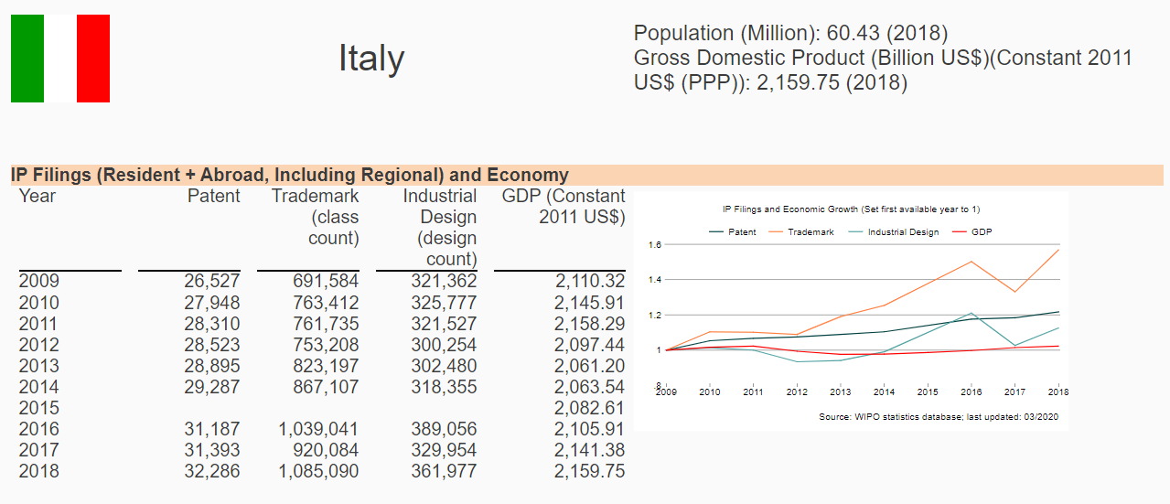
IP PROTECTION
IP filing trends
+21,7% of patent growth in the 2009-2018 timespan
Sources: https://www.wipo.int/ipstats/en/statistics/country_profile/profile.jsp?code=IT; https://www.wipo.int/members/en/details.jsp?country_id=84.
29

Slide 30
Government commitment

Slide 31
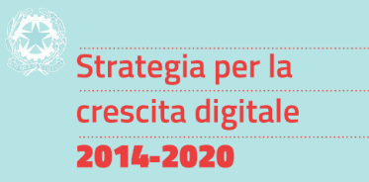

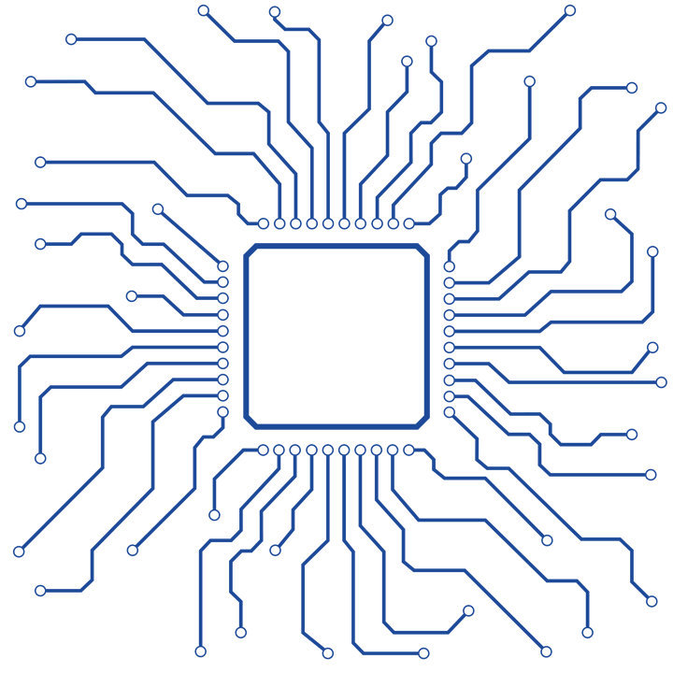

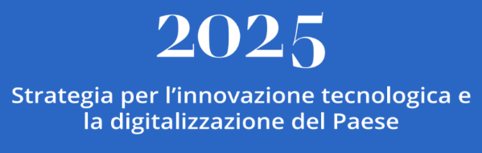
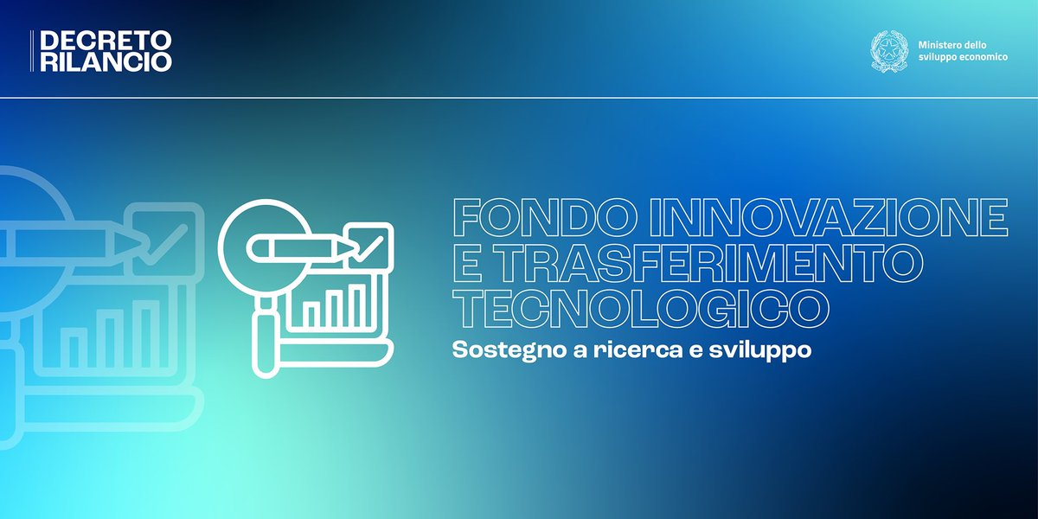

GOVERNMENT COMMITMENT
National innovation & digital strategy
2014-2020
DIGITAL GROWTH STRATEGY
NATIONAL PLAN FOR
THE ULTRA BROADBAND
€ 4,6 bln to implement the European Digital Agenda
NATIONAL INNOVATION FUND and TECH TRANSFER FUND
2025 INNOVATION STRATEGY
Huge resources allocated:
Around € 1 bln for the National Innovation Fund
€ 500 mln for the new Tech Transfer Fund
The new Ministry of Innovation launched this 5-year long strategy at the end of 2019
Aim to boost innovation in the Country, from companies to the P.A.
Strategic sectors: robotics, smart mobility, AI, cybersecurity, etc.
TRANSITION 4.0
A new industrial policy to boost innovation throughout the national economy and the manufacturing processes
31

Slide 32

R&D Public funding
2018 Public funding of ICT Research & Development (€ million)
Italy ranks 2nd among the European five biggest public funders of ICT R&D in 2018 with € 802 mln of spending
Source: DESI 2020, European Commission.
32
Notes:
The EU's five biggest public funders of ICT R&D in 2018 were Germany (€1.8 billion or 26% of public funding in the EU for ICT R&D), followed by Italy (€802 million or 11%), France (€689 million or 10%), the UK (€652 million or 9%) and Spain (€523 million or 7%). Together, those five countries accounted for 63% of total public funding for ICT R&D. (DESI 2020 Report, pag. 114)

Slide 33

Cutting edge connectivity
CONNECTIVITY:
Although in 2020, Italy still ranks 17th in the EU DESI Ranking, it is catching up through huge investments – Italy has indeed improved by +9 spots since 2019 and +2 since 2019
Increase of ultra broadband coverage → up to 90% of families (higher than the 83% EU average)
5G:
Forecasted € 15,7 bln of turnover in ITALY while creating over 186.000 jobs by 2025 permeating all sectors
Italy is one of the most advanced on 5G readiness, 4° in the EU with 13 5G trials (Jan. 2020)
Italy has been chosen to host by 2020 one of the 8 supercomputers acquired by the EuroHPC JU – European High-Performing Computing Joint Undertaking
Sources: DESI 2020, European Commission; Il Digitale in Italia 2019. Mercati, Dinamiche, Policy, Confindustria Digitale, Anitec-Assinform / NetConsulting cube, october 2019; https://eurohpc-ju.europa.eu/
33
Notes:
By the end of 2020, the EuroHPC JU will acquire and install 8 supercomputers: 3 high-range (pre-exascale) supercomputers in Finland, Spain, and Italy that will place Europe back in the world’s top-10; and 5 mid-to-high range (petascale) supercomputers in Luxembourg, Portugal, Czechia, Slovenia, and Bulgaria.

Slide 34

Digital public services
In 2019, Italy registered the highest improvement for e-government services compared to 2018, +12,5%, 5th in the EU
In 2019, Italy registered one of the highest improvement for cross-border mobility of public services, +11,7 points, thus proving that Italy is catching up with the EU ranking
SPID, the Public System of Digital Identification, registered 6,7 mln of released accounts up to may 2020
In 2019, PagoPA, the digital platform for payments to the Public Administration, registered 100 mln of transactions
In 2019, FE, i.e. the Electronic Billing, registered over 2 bln issued bills with 3,9 of economic operators involved
Source: DESI 2020, European Commission;
34
Notes:
Cross-border mobility indicates the extent to which users of public services from another EU country can use the online services of the EU country being assessed.

Slide 35

Transition 4.0
The Transition 4.0 Plan is the country's new industrial policy, more inclusive and attentive to sustainability. In particular, the Plan provides for greater attention to innovation, green investments and design and aesthetic design activities. Here the main actions foreseen:
Tax credit for investments in capital goods: support and encourage companies that invest in new capital goods, both tangible and intangible, functional to the technological and digital transformation of production processes for production facilities located in the State
Research, development, innovation and design tax credit: stimulating private expenditure in Research, Development and Technological Innovation to support the competitiveness of companies and encourage digital transition processes and in the context of the circular economy and environmental sustainability
Training tax credit 4.0: stimulating investment by companies in training of personnel on subjects relevant to the technological and digital transformation of companies
Source: https://www.mise.gov.it/index.php/it/transizione40
35

Slide 36

2025 Innovation Strategy
The 2025 Innovation Strategy is rooted in the UN Sustainable Development Goals (SDGs), whose analysis has led to the identification of three main challenges: the digitization of society; innovation in the country; and the sustainable and ethical development of society as a whole.
All those actions that need to be taken will be carried out through a steering committee established with the other ministries and coordination tables with the territories (municipalities, regions), authorities, central and local agencies and private entities.
The Strategy targeted sectors might be divided between high-tech, i.e. robotics, smart mobilitiy, AI, and cybersecurity, and Made in Italy-related, i.e. manufacturing, tourism, food, fashion, and design.
A case in point is the national framework for the Italian Smart Road project which is meant to allow the testing of Automated Vehicles (AV) on public roads. In October 2018, the first AV drove in the city center of Turin using 5G technologies.
Source: https://innovazione.gov.it/assets/docs/MID_Book_2025.pdf
36

Slide 37
National Innovation Fund
In 2020, in order to progressively make the Italian ecosystem competitive and innovative, the Government has launched a new industrial plan where the Venture Capital would become a cornerstone of innovation in Italy.
The National Innovation Fund budget amounts to approximately € 1 billion, thanks to the resources allocated equally by the Ministry of Economic Development and the Cassa Depositi e Prestiti Group.
The operational instrument of intervention of the National Innovation Fund will be Venture Capital, a sector in which the data of recent years are extremely encouraging. The Fund will operate through direct and indirect investments with a focus mainly on all areas of innovation in which Italy is already able to express traditional excellence or is able to play a leading role in global competition, thanks to the talent and skills of Italian entrepreneurs.
Source: https://www.cdp.it/sitointernet/page/it/cdp_venture_capital__fondo_nazionale_innovazione_gia_operativo_il_piano_industriale_20202022_dallitalia_per_innovare_litalia?contentId=CSA28953
37

Slide 38
Tech Transfer Fund
Among the measures listed within the 2020 Re-Launch Decree, it is noteworthy the creation of an Innovation and Tech Transfer Fund.
In order to support research and experimentation, this new Fund dedicated to technology transfer aims at creating a solid and stable connection between the world of production and research, with the aim of ensuring an adequate level of technology transfer to companies.
The Fund will have an initial endowment of € 500 million for the year 2020 and will be managed by the first Italian foundation entirely dedicated to technology transfer, Enea Tech, which will have to provide the collaboration of public and private entities in the implementation of Innovation projects and in carrying out activities of design, coordination and stimulation of research and development.
Source: https://issuu.com/plus_magazine_gov/docs/brochure_dl
38

Slide 39

Selected incentives and fiscal benefits

Slide 40
INCENTIVES
Large investments – Development contract
Development contract is the main incentive managed by Invitalia. It consists of incentives for one or more connected and functional investment projects (including R&D) of at least € 20 MLN over 3 years, presented by one or more companies also in joint form, in the following sectors:
Manufacturing of electronic components, semiconductors, hardware equipment;
IT and TLC services.
Projects presented by foreign companies providing a strategic investment of at least € 50 MLN can access to Fast Track procedure:
Possibility to jump the queue;
Ad hoc resources;
Time shortening procedures.
The development contract includes various forms of financial subsidies:
Non-repayable grant;
Soft loan (max 3+10 years with subsidized interest rate);
Subsidies for interest repayment on loan.
40

Slide 41



INCENTIVES
Large investments – Development contract
LARGE
MEDIUM
SMALL
ICT manufacturing and services
Southern Regions: Campania, Apulia, Basilicata, Calabria, Sicily and Sardinia
25%
35%
45%
Central-Northern Regions:
only listed cities
10%
20%
30%
H
Rest of Italy
No eligibility
10%
20%
R&D
All the Italian
territory
50% industrial research
25% exp. development
80%
The effective mix of the funds granted can’t exceed 75% of the total eligible expenses.
41

Slide 42
INCENTIVES
Startups and SMEs – Smart & Start Italy
What
The aid supports the creation and growth of innovative startups all over Italy.
Projects must include expenses and eligible costs between € 100K and € 1.5 MIL.
Projects must have a duration not exceeding 24 months, starting after the contract signing.
The valuation procedure lasts only 60 days.
Who
Smart&Start Italy funds the creation and growth of innovative startups that:
Have a strong technological dimension;
Operate in the digital economy;
Enhance search results (spin-offs from research).
Small-sized startups established for no more than 60 months or individuals willing to set up a new company (within 30 days from admission)
Non-Italian Startups must demonstrate the registration in the special section of the Business Register and availability of an Italian operating office.
Subsidies
Interest-free loan up to 80% of the total investment. The percentage of funding may rise to 90% if the startup is composed exclusively by women or young people under the age of 36, or if it includes at least one Italian PhD who is working abroad and intends to return to Italy.
Startups based in Abruzzo, Basilicata, Calabria, Campania, Molise, Puglia, Sardinia and Sicily, will repay only the 70% of the loan amount.
The loan-repayment duration is 10 years.
Startups established by no more than 12 months can use a free of charge technical-management tutoring service by Invitalia.
42

Slide 43
INCENTIVES
Startups and SMEs – Smart & Start Italy
Eligible expenses *
Investment costs:
System, machinery and technological or scientific technical equipment (factory-fresh);
Hardware and software;
Patents, licenses and trademarks;
Certifications, know-how, unpatented technical knowledge;
Design, development, customization and testing of computer architectural solutions and of production technological systems, specialist technological consultancy if functional to the project, investments in marketing and web marketing.
Running costs:
Employees and collaborators wages;
Licenses and rights for industrial property;
Software licenses;
Incubation and acceleration services;
Lease payments, rental costs and amortization fees of systems, machineries and technological equipment not already financed as above;
Interest on external financing.
* Expenses are eligible only if incurred after the date of the proposal submission
43

Slide 44
FISCAL BENEFITS
R&D and Innovation tax credit
ELIGIBILITY
INCENTIVES
Companies of all sizes investing in research and development, ecological transition, technological innovation 4.0 and in other innovative activities
Eligible activities | Investments (€) ** | Tax credit (%) *
Fundamental research, Industrial research and Experimental development | ≤ € 3 MLN | 12%
Fundamental research, Industrial research and Experimental development for innovative startups and SMEs | ≤ € 3 MLN | 24%
Fundamental research, Industrial research and Experimental development in Southern Regions (Abruzzo, Basilicata, Calabria, Campania, Molise, Puglia, Sardegna and Sicilia) | ≤ € 3 MLN | 25% (large enterprise) 35% (medium enterprise) 45% (small enterprise)
Technological innovation (design, implementation, introduction) | ≤ € 1.5 MLN | 6%
Technological innovation “Industry 4.0” and green economy (design, implementation, introduction) | ≤ € 1.5 MLN | 10%
Design - Aesthetic conception (conception and realization of new products and samples within the textile and fashion, footwear, eyewear, goldsmith, furniture and furnishing and ceramic sectors) | ≤ € 1.5 MLN | 6%
ELIGIBLE EXPENSES
Personnel;
Depreciation charges, financial or simple lease payments and other expenses relating to tangible assets and software used in R&D projects (up to 30% of the expenses related to personnel);
Research contracts;
Depreciation charges relating to the purchase from third parties, also under license of use, of industrial property rights relating to an industrial or biotechnological invention, up to a maximum of € 1 MLN;
Consultancy (up to 20% of the expenses related to the personnel);
Materials for R&D projects (up to 30% of the expenses related to personnel or research contracts).
The effective payment of the eligible expenses must result from a specific certification issued by a company’s statutory auditor. For companies not legally obliged to audit statutory accounts, the costs incurred are recognized for an amount not exceeding € 5,000.
* Compensation
3 years
** net of other grants or contributions for any reason received for the same eligible expenses
44

Slide 45
FISCAL BENEFITS
Patent box and equity growth
PATENT BOX
ACE – Help for Economic Growth
The patent box benefit consists in a partial tax deduction of 50% for incomes arising from direct use or licensing of qualified intangible assets:
Property rights;
Industrial patents;
Trademarks;
Designs and models, as well as processes, formulas and information relating to experiences acquired in legally protected industrial, commercial or scientific fields
Fiscal deductibility on IRPEF (personal income tax) or IRES (tax on company revenues)
Legal entities with a business income must be able to demonstrate that their income is from the use of intangible assets
Access to the benefit is automatic in the preparation of financial statements and for a 3-years time period, providing adequate documentation
The incentive aims at encouraging the capitalization of companies through the possibility of deducting from the net income, up to the amount of the same, an amount (notional yield) determined as an increase in equity.
The applied tax rate on company revenue (IRES) only for this specific amount is 1.3%.
To calculate the ACE incentive, the positive and negative elements of the capital increase must be algebraically added
The result obtained must be compared with the shareholders' equity resulting from the financial statements for the year including the profit or loss. The tax base is equal to the lower of the two amounts.
45
Notes:
Deduction (deduzione): reduction of the tax base (taxable income)

Slide 46
FISCAL BENEFITS
Investments in innovative startups/SMEs
ELIGIBILITY
INCENTIVES
Legal or natural persons investing directly or indirectly in one or more innovative startups or SMEs
Mature companies invest in the acquisition of the entire share capital of innovative startups, only if the acquisition is maintained for at least 3 years
The benefit applies to contributions in cash in the company share capital and in the reserves of innovative startups and SMEs or of companies investing mainly in the capital of innovative startups or SMEs
Fiscal subject | Investments (€) |  | Fiscal deductibility (%)
Natural persons | ≤ € 1 MLN | 50% *
Legal persons | ≤ € 1.8 MLN |  | 60% *
Mature companies | ≤ € 15 MLN |  | 100% *
* Waiting for final approval. The existing regulation provides a 30% and 50% fiscal deductibility
WHAT
Fiscal deductibility on IRPEF (personal income tax) or IRES (tax on company revenues)
46

Slide 47
FDI case studies

Slide 48














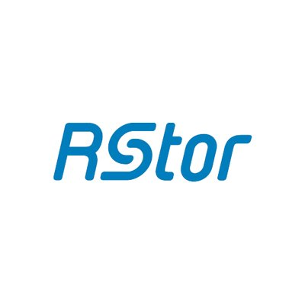

ICT FOREIGN COMPANIES
Home to international players
Some ICT global leaders with recent investments in Italy
with R&D labs, software development activities, innovation and competence centers, tech academies, and more
890 ICT foreign owned firms in Italy with over 150K employees and more than € 47 bln turnover in 2017
Source: Reprint database.
48
Notes:
890 ICT foreign owned firms (61, 62, 63) with 150.751 employees and € 47.022,7 mln turnover in 2017
90 foreign owned firms (61 – TLC) with 62.985 employees and € 30.909,1 mln turnover in 2017
800 foreign owned firms (62 and 63 – IT) with 87.766 employees and € 16.113,6 mln turnover in 2017
670 foreign owned firms (62 – computer programming, consultancy, and rel. act.) with 75.755 employees and € 14.090,5 mln turnover in 2017
130 foreign owned firms (63 – information service activities) with 12.011 employees and € 2.023,1 mln turnover in 2017

Slide 49
Successful investments in depth
49
Notes:
R-STOR (MARCO)
IBM Rieti
Apple in Napoli
Cisco in Napoli e Milano
https://www.linkiesta.it/it/blog-post/2020/01/24/cisco-inaugura-a-milano-il-cybersecurity-co-innovation-center/28719/
Huawei (vedi materiale: Milano + collab con molte università)
Amazon – Development center in Torino
NTT Data
EON
https://eonreality.com/interactive-digital-centers/

Slide 50

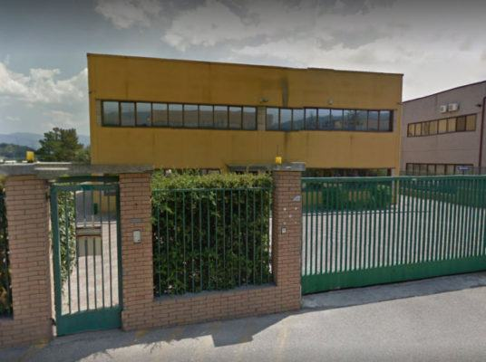
NTT Data in Cosenza
The Japanese multinational NTT Data, with $ 105 bln of turnover and about 275.000 employees in 88 countries, counts 3 main innovation centers in the world: in Silicon Valley, in Tokyo, and Rende, Cosenza.
The Cosenza Center is part of the Cybersecurity Tech District, a center of excellence in Europe which integrates industrial skills and methodologies from the world of universities and research centers.
Since the acquisition of the startup Value Team in 2011, NTT Data, operates in the cybersecurity and robotics sectors, and is now working on the NariNAVI App – a geo-localization app to allow people to move safely.
NTT Data may count on a territorial innovative and technological ecosystem. Indeed, the University of Calabria represents a key source of skills and knowledge in the engineering field.
"We are very proud to contribute to the growth of our country […], a development generated by the work and commitment of all our Italian employees, which in recent years have enabled the group to achieve important results in economic and performance terms. The Cyber Security sector in the coming years will be at the center of tech innovation and we want to be the leader of this growth." said NTT Data Italy CEO Walter Ruffinoni.
NTT Data in Rende, Cosenza
50
Sources: NTTDATA website; https://www.esperia.tv/tecnologia-made-in-sud-la-favola-di-ntt-data-di-rende-cs/; https://www.identitainsorgenti.com/ntt-data-investe-a-napoli-e-cosenza-previsti-300-nuovi-posti-di-lavoro/
Notes:
Company
NTT registered $ 105 bln of turnover with 275.000 employees in 88 Countries. Nel gruppo NTT ben 6 mila persone si occupano di ricerca e sviluppo e possono contare, ogni anno, su 2,5 miliardi di dollari di investimento. nel mondo, lavorano per NTT DATA oltre 110mila persone. All’innovazione sono dedicati anche tre centri d'eccellenza dislocati nel mondo: nella Silicon Valley, a Tokio e a Cosenza. Quest’ultimo, strettamente collegato ai primi due, fa parte del Distretto Tecnologico Cybersecurity (DCS), un polo all’avanguardia in Europa che integra competenze industriali e metodologie provenienti dal mondo dell’Università e dai centri di ricerca. In Italia, inoltre, è basata Digital Entity, una business unit che, unendo innovazione tecnologica, creatività e competenze di design, accompagna la trasformazione delle aziende, in qualunque settore operino, in un’ottica digitale.
Country
Toyosu, Tokyo, Japan
Investment sector
ICT
Project
La multinazionale in Calabria è arrivata grazie ad una startup, impiantata da Giorgio Scarpelli, Emilio Graziano e Francesco Gargano nel 2001 in un bilocale di via degli Stadi. Specializzata in sicurezza informatica, VpTech nel 2010 si fonde con Value Team, che l’anno dopo sarebbe entrata nella galassia di Ntt Data. A due passi da Arcavacata di Rende, sede dell’Università della Calabria, si progetta la Cyber Security e la robotica, ma anche l’applicazione NariNAVI, sviluppata dal colosso giapponese sulla base di un’idea della startup calabrese GIPStech. Un’applicazione che consentirà di muoversi in sicurezza utilizzando un servizio di localizzazione interna per determinare la propria posizione e capire come muoversi per arrivare al luogo di destinazione. Un app che utilizza il posizionamento geomagnetico per visualizzare la posizione corrente dell’utente sul proprio smartphone in tempo reale su una mappa tridimensionale dello scalo.

Slide 51

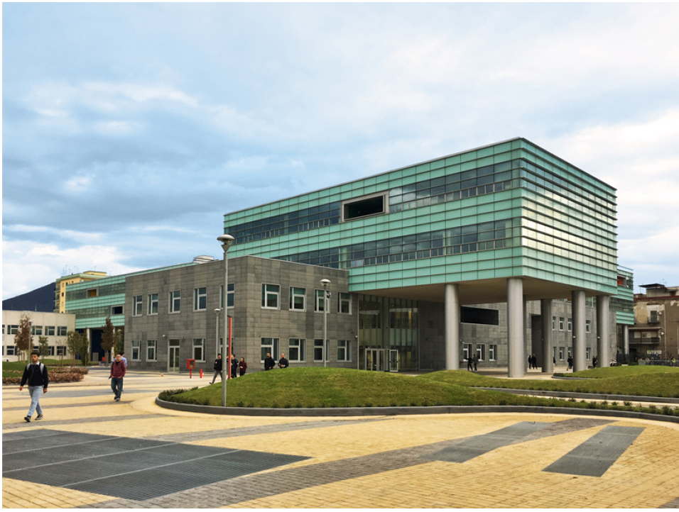
Apple in Naples
In 2016, the technology giant Apple opened its first European Academy in San Giovanni a Teduccio, Naples.
The iOS Developer Academy, a joint project between Apple and the Federico II University in Naples (UNINA), trains students in app and software development.
Each year, circa 100 students can study for free – thanks to granted scholarships – at the Academy in UNINA. The Academy’s format foresees 6 months of classes followed by a semester of training on a project with a company. The best students may even work in Apple.
The University of Naples Federico II is the oldest public university in the world, and the 3rd university in Italy ranked by enrolled students.
"Europe is home to some of the most creative developers in the world and we're thrilled to be helping the next generation of entrepreneurs in Italy get the skills they need for success […]" said Apple CEO Tim Cook.
"We are thrilled to be working with University of Naples Federico II to launch the first iOS Developer Academy in Europe […]" said Apple's CFO Luca Maestri in July when the company announced the investment location.
HQ of the Apple Academy, in San Giovanni a Teduccio Pole, Naples
51
Sources: https://www.thelocal.it/20161006/apples-academy-opens-naples-investment-italy; https://appleinsider.com/articles/16/10/05/apples-first-european-ios-developer-academy-opening-on-thursday-in-naples-italy
Educational and research activities about (and around) refrigeration, A.W. Mauro, UNINA

Slide 52

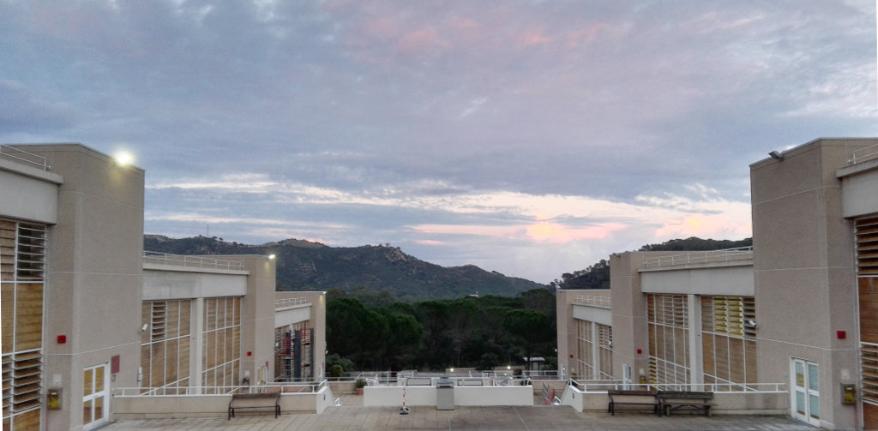
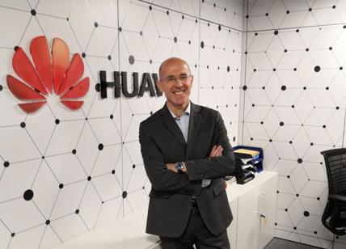
Huawei in Cagliari and Milan
The Chinese tech multinational Huawei has strongly invested in Italy in R&D, Innovation Centers, and Labs as well as through collaborations with Italian Universities.
In 2008, Huawei established an R&D Center in Segrate, Milano, which serves the company all over the world since 2011. Also, since 2016, its scope of research increased, including 5G. In 2016, the R&D Center registered: 100 researchers, 30 patents filed, projects with many universities and highly specialized electronics SMEs.
In 2016, Huawei established a Joint Innovation Center in Pula (Cagliari) together with CRS4 in order to develop solutions for smart and safe cities. E.g. their eLTE solution supported the rescue operation during Rigopiano avalanche. The investment has foreseen € 20 mln commitment.
Huawei answered the question ‘Why investing in Italy’ by listing: “Open market; Fair competition; No prejudices on foreign companies; New fiscal approach and tools for foreign investor and large taxpayers; Human capital and highly skilled ICT workforce; Healthy enterprises ecosystem and availability of valuable partners; Good trade relationships between Italy and China.”
HQ of Joint Innovation Center inside the CRS4 building, in Pula, Cagliari
Renato Lombardi, Director of the R&D center in Segrate, Milano
52
Sources: ‘Building a Better Connected World’, Huawei, 2016; http://www.jicsardegna.it/; https://www.affaritaliani.it/mediatech/huawei-italia-centro-di-ricerca-segrate-651312.html
Notes:
Company
Huawei Technologies Co., Ltd is a Chinese multinational technology company. It provides telecommunications equipment and sells consumer electronics, smartphones[4] and is headquartered in Shenzhen, Guangdong.
Country
Shenzhen, China
Investment sector
ICT
Project
DIRECT INVESTMENTS IN ITALY: R&D, Innovation Centers, Labs →
Milano Research Center: established in 2008 in Segrate, become Global R&D in 2011, serves the company all over the world; 100 researchers, led by Huawei Fellor; partners with Lombardy highly specialized electronics SMBs; 30 patents filed at now; increase scope of research since 2016, including 5G; joint projects with Politecnico of Milan, University of Pavia, University of Trento, University of Padua; +1 mln EUR invested in 2016
Joint Innovation Center in Pula (CA): established in Dec 2016 in Pula, close to Cagliari; joint investment with Sardinia Region, 20 mln Euro commitment; mission: develop solutions for smart and safe cities; collaboration with 6 regional SMBs, indirect turnovver generation; already provided one best practice outside of Sardinia (eLTE solution to support rescue operation during Rigopiano avalanche)
INDIRECT INVESTMENTS IN ITALY: Univeristies’ collaborations

Slide 53

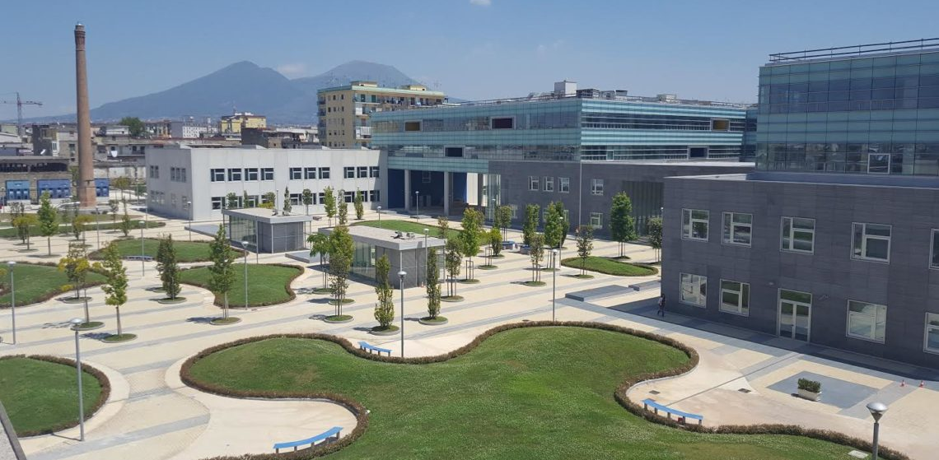
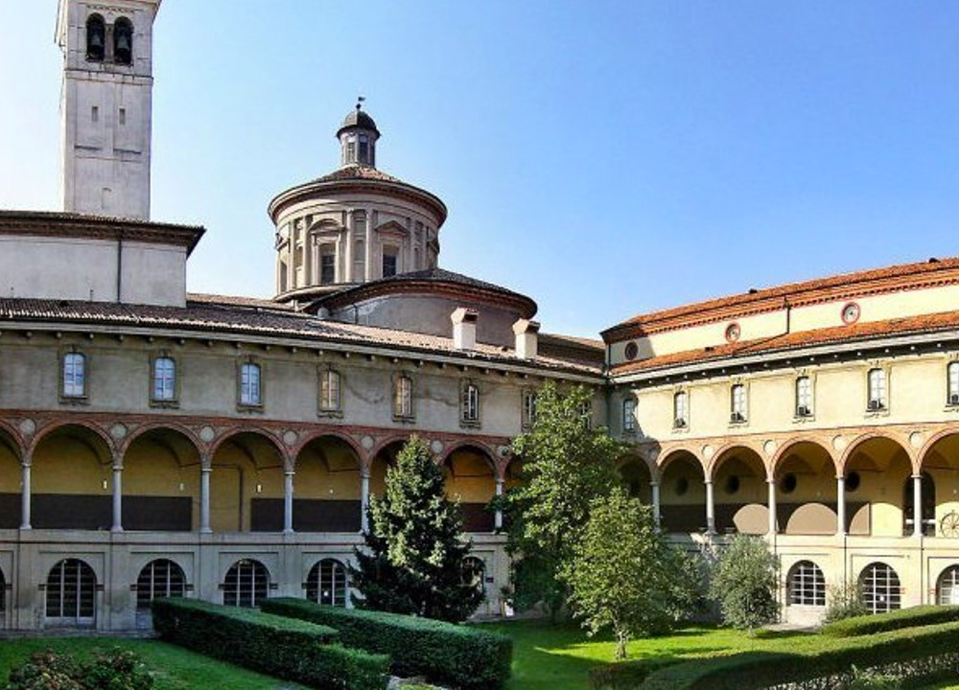
Cisco in Naples and Milan
The American tech conglomerate Cisco Systems has several investments in Italy and may count on multiple partnerships with universities.
In 2008, Cisco established a Digital Transformation Lab in San Giovanni a Teduccio, Naples, providing a 6-month-academic path aimed to train future professionals able to guide companies towards digital innovation. Also, the Academy, also thanks to the partnership with Federico II University aims to develop new digital solutions together with local companies.
In 2020, Cisco established a Cybersecurity Co-Innovation Center in Milan inside the National Museum of Science and Technology ‘Leonardo Da Vinci’. This Center is part of the international Cisco co-innovation centers network and represents the 1st in Europe to be dedicated to IT and privacy.
“[…] By increasing its investments, Cisco will develop an ecosystem of talent, entrepreneurship and innovation that will accelerate the country's [Italy] digital path and help it seize the unprecedented opportunity it faces.” said Cisco CEO Chuck Robbins.
HQ of Digital Transformation Lab, in San Giovanni a Teduccio Pole, Naples
HQ of Co-Innovation Center inside the National Museum of S. & T. in Milan
53
Source: https://www.linkiesta.it/blog/2020/01/cisco-inaugura-a-milano-il-cybersecurity-co-innovation-center/; https://www.cisco.com/c/it_it/about/news/2018-archive/20181106.html;
http://www.learningacademyct.it/Portale/soluzioni/8-news/27-cisco-investe-100-mil-di-in-italia
Notes:
Company
Cisco Systems, Inc. is an American multinational technology conglomerate headquartered in San Jose, California, in the center of Silicon Valley. Cisco develops, manufactures and sells networking hardware, software, telecommunications equipment and other high-technology services and products.[3] Through its numerous acquired subsidiaries, such as OpenDNS, Webex, Jabber and Jasper, Cisco specializes in specific tech markets, such as the Internet of Things (IoT), domain security and energy management.
Country
San Jose, California, USA
Investment sector
ICT
Projects
(24 gennaio 2020) Ha aperto i battenti oggi a Milano, presso il Museo Nazionale Scienza e Tecnologia Leonardo da Vinci, il Cybersecurity Co-Innovation Center di Cisco. Il centro è stato inaugurato alla presenza del Ministro per l’Innovazione Tecnologica e la Digitalizzazione Paola Pisano, di Roberto Baldoni, Vice Direttore Generale del DIS (Dipartimento Informazioni per la Sicurezza) della Presidenza del Consiglio con delega alla cybersecurity, del Presidente della Regione Lombardia Attilio Fontana, di Roberta Cocco Assessora alla Trasformazione Digitale e Servizi Civici del Comune di Milano e del Direttore Generale del Museo, Fiorenzo Galli. Per Cisco è intervenuto il CEO Chuck Robbins; al suo fianco anche l’AD di Cisco Italia Agostino Santoni e molti top manager internazionali che hanno sostenuto questa iniziativa. Il nuovo centro fa parte di una rete mondiale di centri di co-innovazione Cisco ed è il primo in Europa a essere dedicato principalmente alla sicurezza IT e alla privacy. Il Museo diventerà una delle Cisco Networking Academy, dove saranno offerti corsi dedicati sia ai giovani che a coloro che già lavorano e desiderano riqualificarsi con le competenze del futuro.
Cisco Digital Transformation Lab a Napoli
2018 – ongoing
Academic path aimed at training future professionals able to guide companies towards digital innovation
Il Digital Transformation Lab creato da Cisco presso l’Università Federico II di Napoli apre le porte a studenti, aziende e start up. Nella struttura, ospitata presso il Polo Universitario di San Giovanni a Teduccio, sarà erogato un percorso di formazione unico nel suo genere, il “Cisco Digital Ready Networking Bootcamp”, da cui usciranno i professionisti capaci di guidare il cambiamento delle aziende verso l’innovazione digitale. Il corso, che ha la durata di sei mesi, prevede formazione in aula e una fase di project work, dedicata a sviluppare prototipi di nuove soluzioni digitali, con il coinvolgimento di aziende del territorio.

Slide 54
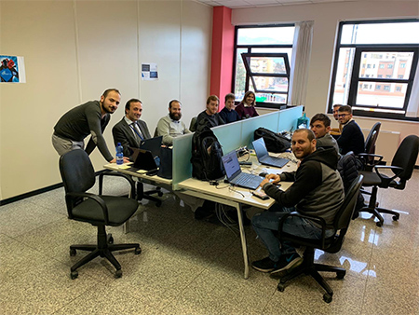
IBM in Rieti
The American tech multinational IBM operates in over 170 countries, with more than 350.000 employees and $ 13,21 bln of net income.
IBM Services, the division dedicated to the strategic and digital transformation of companies, together with the experience of Information Systems, was essential for the birth of the Innovation Center in Rieti in 2019, thus becoming 1 of the 16 IBM innovation centers in Europe.
This Innovation Center, co-funded by the Ministry of Economic Development and Lazio Region, aims to promote digital transformation and the development of innovative projects by SMEs.
IBM can count on several collaborations with regional universities focused on R&D regarding the development of new technologies, such as Sabina Universitas.
"This initiative is part of the Accelera Italia program that IBM has been carrying out […] for months. It is also a positive example of […] involving institutions, local businesses, universities and the younger generations to encourage innovation and the development of new professional skills that integrate the exponential technologies now essential to be competitive in a global scenario." said IBM Italy CEO Enrico Cereda.
IBM Italy team in Rieti
54
Source: https://www.ibm.com/easytools/runtime/hspx/prod/public/X0027/PortalX/page/pageTemplate?s=78c374df5c884363b46454a5ffefb5d9&c=8fdc93ceda2b4cd79f5349cfee23e804
Notes:
Company
IBM is an American multinational technology company operating in over 170 countries, with over 350.000 employees and $ 13,21 bln of net income. The role of IBM Services, the division dedicated to the strategic and digital transformation of companies, together with the experience of Information Systems, has been essential for the birth of the Innovation Center in Rieti.
Country
Armonk, New York, USA
Investment sector
ICT
Project
Opening of an Innovation Center in Rieti to promote the digital transformation and the development of new innovative projects by SMEs.
Il nuovo Innovation Center di Rieti ha lo scopo di promuovere la trasformazione digitale e lo sviluppo di progetti innovativi per aziende grandi e piccole, con una focalizzazione su alcuni specifici settori d’industria. Questo polo, nato nel 2019, è frutto di un progetto di Sistemi Informativi, società del Gruppo IBM, nell’ambito degli accordi di innovazione e co-finanziato dal Ministero dello Sviluppo Economico e dalla Regione Lazio.
L’obiettivo è duplice: da un lato la creazione di una unità operativa altamente focalizzata sulla ricerca e lo sviluppo di soluzioni tecnologiche all’avanguardia, resa possibile dalla stretta collaborazione con la Sabina Universitas e, più in generale, con le università regionali nelle vicinanze; dall’altro la cooperazione in un contesto economico e sociale complesso ma dalle grandi opportunità, per contribuire alla spinta per la ricostruzione e il rilancio occupazionale del territorio reatino, colpito dal terremoto nel 2016.
Investment value
Value: $ 18 mln
Jobs: xx
Con un investimento totale di circa 18 milioni di euro, questa iniziativa si colloca come uno dei 16 centri di innovazione aperti da IBM in tutta Europa. La nascita dell’Innovation Center di Rieti, infatti, non vuole essere un intervento isolato ma un progetto ampio per favorire la formazione di nuove professionalità e competenze su tecnologie emergenti ed innovative sulle quali investono i principali settori di mercato.

Slide 55

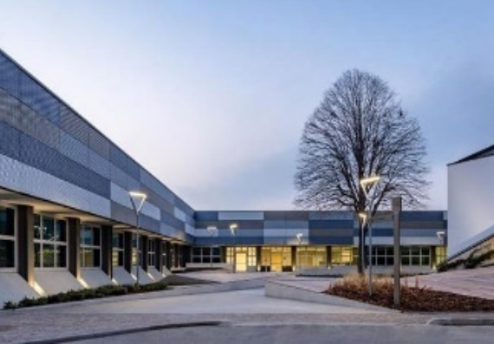
EON Reality in Bologna
In 2018, EON Reality – the world leader in Virtual Reality (VR) and Augmented Reality (AR) based knowledge transfer for industry and education – announced the establishment of an Interactive Digital Center (IDC) in Bologna.
EON Reality Bologna will help build the foundation of a local Advanced VR ecosystem and support the region’s economy by helping companies and industries to improve their productivity and safety.
The IDC also contains a VR Innovation Academy (VRIA) that will train new Augmented Reality and VR professionals who will support EON Reality and other companies in their AR and VR endeavors.
EON Reality can especially take advantage of the internationally recognized infrastructure capacity and tech excellence of the Emilia-Romagna region.
"In Emilia-Romagna, we see a great opportunity to improve local knowledge transfer and to bring regional expertise to the global community, […] we look forward to addressing the needs of the regional market with the AVR Platform and we are excited about the ability to develop unique knowledge transfer applications built on local expertise." said EON Reality CEO David Scowsill.
EON Reality location in Bologna
55
Source: https://eonreality.com/eon-reality-to-establish-augmented-and-virtual-reality-center-in-bologna-italy/
Notes:
Company
Scaleup founded by former Facebook executives, and funded by Cisco
Country
Saratoga, California, USA
Investment sector
ICT
Project
EON Reality, Bologna IT. IDC & VR Innovation Academy. EON Reality Bologna will help build the foundation of a local AVR ecosystem and support the region’s economy by helping companies and industries to improve their productivity and safety. The IDC supports education in the region, as well as handles EON Reality’s sales and marketing, along with R&D in Augmented Reality and Virtual Reality.
IRVINE, CA, May 30, 2018 – EON Reality Inc., the world leader in Augmented and Virtual Reality (AVR) based knowledge transfer for industry and education, and Regione Emilia-Romagna today announced the establishment of an Interactive Digital Center (IDC) in Bologna, Italy.
This IDC, known as EON Reality Italy, will help build the foundation of a local AVR ecosystem and support the region’s economy by helping companies and industries to improve their productivity and safety. EON Reality Italy will play an important role in the industrial upgrade strategy of the Region and will offer precious experiential training to students, businesses, and professionals through a regional rollout of the AVR Platform. Also, the IDC will become the Italian hub for the development of content and applications related to Augmented and Virtual Reality and the AVR Platform. The IDC also contains a VR Innovation Academy (VRIA) that will train new AR and VR professionals who will support EON Reality and other companies in their AR and VR endeavors.

Slide 56

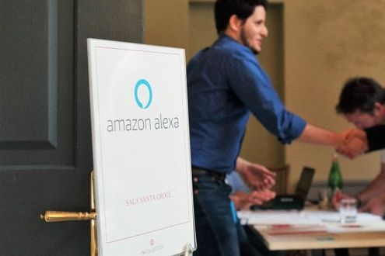
Amazon in Turin
The American tech company Amazon.com has invested more than € 450 mln and created 1.700 jobs in Italy since opening in 2010.
In 2016, Amazon.com established a new Artificial Intelligence and Machine Learning Development Center in Turin.
This Center aims to develop Machine Learning capabilities for Alexa, Amazon’s cloud-based voice service that powers millions of Alexa-enabled devices including Amazon Echo. Also, the new center will be dedicated to advancements in speech recognition as well as natural language understanding.
Amazon.com can particularly count on technological and innovative ecosystem in Turin, thanks to synergies among the Polytechnic and incubators, and many other tech actors.
" We are happy to launch a Machine Learning center in Turin, a city full of talents in the field of machine learning technologies, of direct interest to Alexa. Our centre in Turin will play a key role in the development of Alexa's language understanding skills." said Vice-President and Chief Scientist for Alexa Rohit Prasad.
“We continue to invest heavily in Italy and are creating hundreds of jobs.” - Amazon Italy CM Francois Nuyts.
Amazon Alexa in Turin
56
Source: https://amazon-press.it/service/Recherche/Pressedetail.html?pid=0203b1bd-ad4e-454e-a64e-1058ca364935; https://torino.repubblica.it/cronaca/2019/01/24/news/amazon_si_affida_a_torino_per_lanciare_in_italia_alexa-217329971/
Notes:
Company
Amazon.com, Inc. is an American multinational conglomerate technology company based in Seattle, with 750,000 employees.[8] It focuses on e-commerce, cloud computing, digital streaming, and artificial intelligence. It is considered one of the Big Four technology companies, along with Google, Apple, and Facebook. It has been referred to as "one of the most influential economic and cultural forces in the world.“
Country
Seattle, Washington, USA
Investment sector
ICT
Project
Amazon to open a New Artificial Intelligence and Machine Learning Development Center in Turin. Amazon will hire scientists to develop Machine Learning capabilities for Alexa, Amazon’s cloud-based voice service that powers millions of Alexa-enabled devices including Amazon Echo. Due to open by the end of 2016, it will be Amazon’s 15th Development Center in Europe. Amazon has invested more than EUR450 million in Italy since opening in 2010. Amazon today announced that it will open a new Development Center in Turin focused on developing Artificial Intelligence and Machine Learning capabilities for Alexa, Amazon’s cloud-based voice service behind Amazon Echo, Echo Dot, Amazon Fire TV and Amazon Tap. Opening before the end of 2016, the new center will be dedicated to advancements in speech recognition and natural language understanding.
In Italy, Amazon has invested more than €450 million and created 1.700 jobs in Italy since its opening in 2010. The jobs are currently located at the Castel San Giovanni Fulfillment Center, the Urban Fulfillment Center in Milan serving Prime Now customers, its corporate offices in Milan in 2012 and its Italian Customer service center in Cagliari.

Slide 57
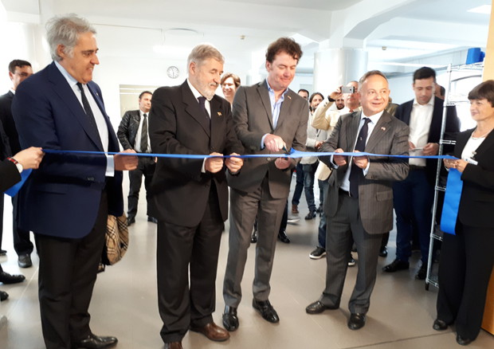
Rstor in Genoa
RStor is a startup which has recently developed an advanced technology in the Enterprise Cloud Computing sector in Saratoga, Silicon Valley.
Their first Italian investment came in 2018 with the opening, in 2019, of RStor Italy in Genoa. The startup plans to develop an innovative cloud service for the hyperscale storage of unstructured data.
The investment has foreseen 6 job positions for Software Engineers at launch, eventually to double, and about $ 3 mln of investment value. RStor accessed the Invitalia Smart&Start incentive.
Italy can count on tech and science knowledge and skills so as to ensure the success of this investment.
Also, Genoa hosts the HQ of Italian Institute of Technology (IIT), thus representing a key source for specialized human capital.
During the inauguration ceremony, RStor declared:
“We are pleased to see a positive outcome to this operation. We would like to thank the Italian institutions in San Francisco and Genoa, which immediately grasped the importance of the initiative, for the support given to this operation. We hope that our entry into Italy will also serve as a forerunner for other important realities in Silicon Valley.”
Inauguration ceremony – May 20, 2019
57
Source: https://www.ansa.it/pressrelease/liguria/2019/05/20/rstor-sceglie-genova-per-il-suo-quartier-generale-europeo_6e4f7b0b-eae5-487f-b7ca-86577d18bfbc.html
Notes:
Company
Rstor è un’azienda della Silicon Valley che ha recentemente sviluppato una tecnologia avanzata nel settore dell’Enterprise Cloud Computing.
Ha raccolto finanziamenti early-stage anche da Cisco Systems, con una valutazione di oltre $200Mln.
Il fondatore di Rstor è Gio Coglitore, tra i più famosi della Silicon Valley nel settore dello Storage e Cloud Computing: ha fondato Rackable Systems (IPO) e Optical Archive acquisita da Sony. Gio Coglitore è famoso per aver progettato le server farm di Facebook.
L’azienda è in fase di startup, ha 30 dipendenti totali a Saratoga (Silicon Valley). A settembre 2018 ha costituito R-Stor Italy.
Country
Saratoga, California, USA
Investment sector
ICT
Project
l'impresa mira allo sviluppo di un innovativo servizio cloud per lo hyperscale storage di dati non strutturati, ossia che consentano di archiviare quantitativi elevatissimi di dati attraverso lo sviluppo di algoritmi adattivi di machine learning ed intelligenza artificiale. L'obiettivo principale è una clientela di tipo corporate/business che necessita di utilizzare dati su larga scala e rapidità di risposta. R-Stor Italy Srl avrà sede a Genova, presso Edificio Millo nell'area del Porto Antico (circa 400 m2). La sede sarà disponibile da Marzo 2019. Il piano d'impresa prevede l'assunzione di 16 dipendenti: 10 programmatori informatici liv. 5, 3 programmatori informatici liv. 6, 2 programmatori informatici liv. 7 (di cui un PhD specializzato sull'intelligenza artificiale) e 1 risorsa marketing/sales liv. 5. Nelle intenzioni dell’azienda costituirà l’HQ europeo.
Investment value
Value: $ 3 mln
Jobs: 6 Senior SW Engineers at launch, doubled to 12
l’investimento previsto dall’azienda è tra i 2 e i 3 milioni di euro. Il contributo richiesto dall'impresa nella forma del prestito a tasso zero, tramite il programma Smart&Start Italia, è pari a circa € 1.044.184,10 ovvero corrispondente a circa il 70% del totale costi ammissibili (€ 1.491.691,58). Sommando le spese non ammissibili si arriva a circa € 1,6 milioni. R-Stor Italy Srl nel piano di investimenti riporta di poter contare, oltre che sul finanziamento a tasso zero, anche su ulteriori fonti (sul triennio) pari a € 1,3 milioni derivati da finanziamento soci, oltre ai 10.000 € di capitale sociale. L'impresa ipotizza di raggiungere un fatturato al terzo anno di attività pari a circa € 8 milioni, con MOL di circa € 5,5 mln ed utile pari a € 4,5 mln.

Slide 58


